Slide 1

North Long Beach Collaborative
Welcome
Trust - Community - Leadership

Slide 2

Centering the Day
Overview of the Day
Welcome
Re-center on NLBC Project Outcomes
Cohort Projects & Ecumenical Summary Presentations
Break
Activities: What We Build Together
Next Steps/ Acknowledgments
  One Word Check - In
  Name
  What cohort did you participate with or what community do you represent?
  In one word - How are you showing up today?

Slide 3




Welcome
Design Team – Helped Steer the Project
Administrator and Technical Provider
Notes:
Frame the day as a milestone and acknowledge community leadership
Acknowledge presence of:
• CD 8, District Director, JoLatta
• Rudy Hernandez, Program Officer with United Way of Greater Long Beach,
• Alicia Megofna, Principal, Odyssey STEM Academy

Slide 4
NLBC Background– Building and Strengthening Resident Capacity
An initiative to build neighborhood team and increase social connectedness to expand NLBC
Landscape Analysis
Community Meeting Kick Off – Dec. 2023
Completed Aug. 2024
Re-engaged project June 2025
Community Projects
Mini-grants for cohort neighborhood projects
(Dec. 2025- March. 2026)
NLBC Convening
Showcase projects
Uplift North LB priorities
(March 2026)
NLBC Cohort Trainings
25 residents
3-classes
Stipend @ end of trainings
(Nov. – Feb. 2025)
Notes:
Ana – provide background

Slide 5
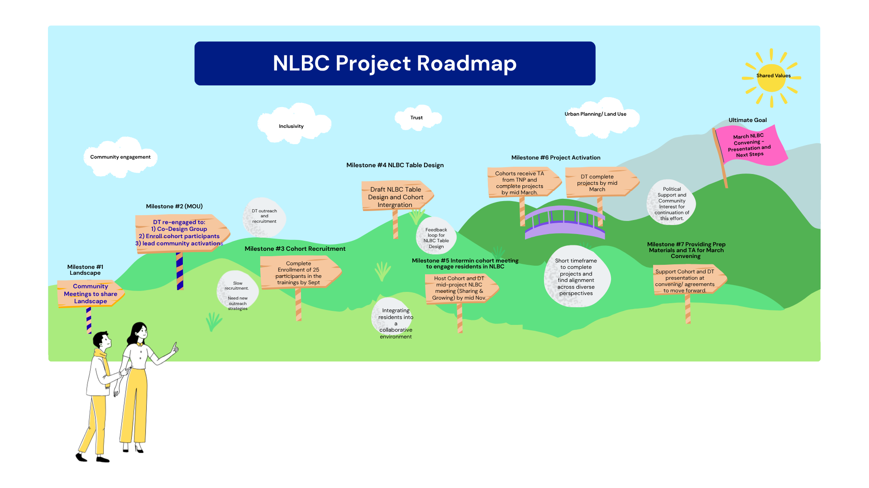
9 - Month Process (Typically 12-15 months)

Slide 6

Design Team Acknowledgments
Thank you to Design Team Leads
Notes:
Dennis Acknowledges Design Team for assisting with this process. Introduces Dr. Thompson, one of the design team members to share about his Aloha Leadership Project.

Slide 7



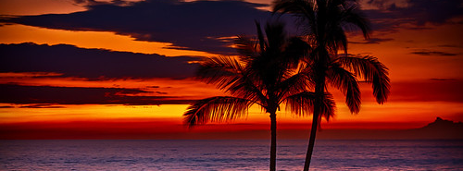
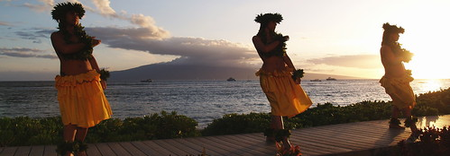
*Aloha*Alii*Bula*Fakaalofa lahi atu*Hafa adai*Iokwe*Ia orana*Kia orana*Kia Ora*Ko na Mauri*Malo e lelei*Mogethin*Talofa
This Photo by Unknown author is licensed under CC BY-NC-ND.
National Pacific Islander Education Network (NPIEN) Projects
This Photo by Unknown author is licensed under CC BY.

Slide 8
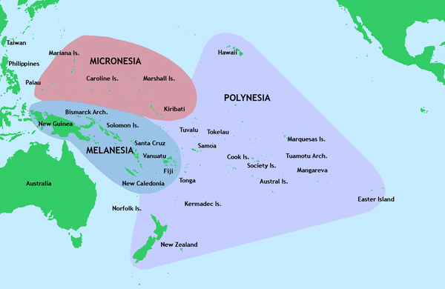
30,000 islands, 2,000 languages
This Photo by Unknown author is licensed under CC BY-SA.

Slide 9
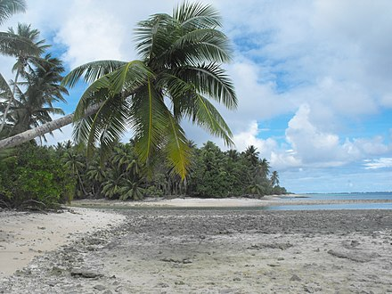
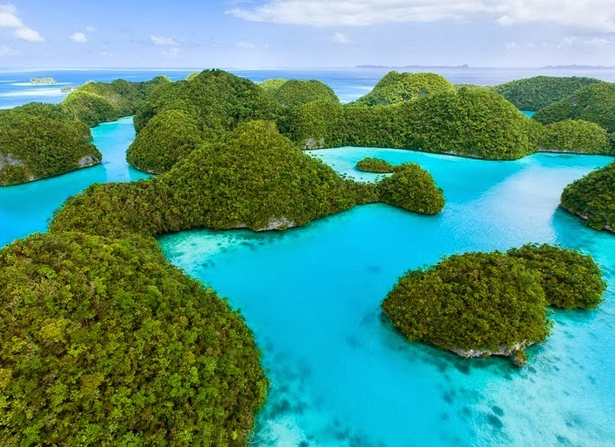
NPIEN's Village Team
NPIEN Board of Directors: Dr. D. Kalani Heinz, President, Wayne Manu. President Elect, Alicia Megofna, Director, Cliff Kusaba, Director***
Dr. Victor Thompson, Executive Director
NPIEN Staff: Project Assistant, Elepise Leiataua, Staff Members Alofaifo Faleono***, Maegan Bautista, Gene Alyanah
*** = North Long Beach Residents
This Photo by Unknown author is licensed under CC BY-SA.
This Photo by Unknown author is licensed under CC BY.

Slide 10
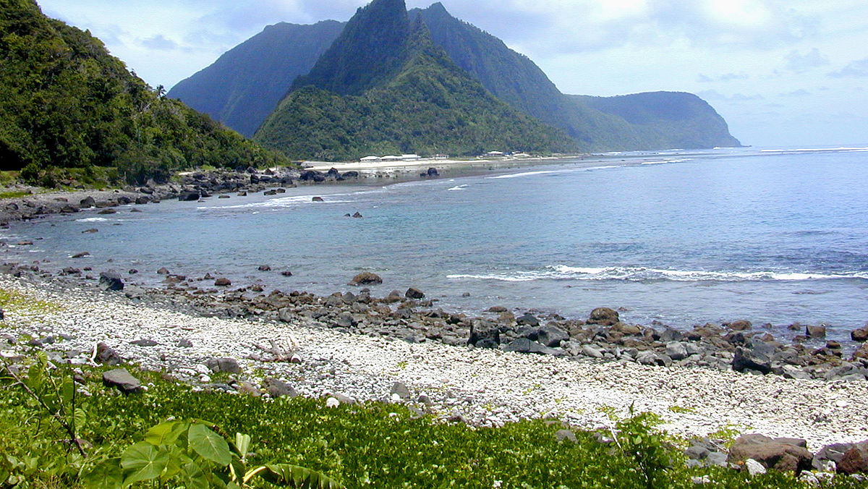

Five Villages: The School Partners
Paramount Unified School District# and Long Beach Unified School District**
#Collins Elementary School: Margie Domino, Principal, Rebecca Johns, Assistant Principal
#Buena Vista High School: Ebony Jordan, Principal, Leslie Leonard, Assistant Principal, Sharon Bryant, Counselor, Kelly Gray, School Social Worker
#Odyssey STEM Academy: Alicia Megofna, Principal, Dr. Joseph Archival, Assistant Principal, Daniel Leyva, Counselor
**Grant Elementary School: Clarissa Tolentino, Principal, Ivonne Gaitan, Office Manager, Luke Davis, Assistant Principal, Allison Voortman, Counselor
**Starr King Elementary School: Jandella Faulkner, Principal, Erin Starks, Parent Community Facilitator, Jackie Eliopoulos, Office Manager
This Photo by Unknown author is licensed under CC BY-SA.

Slide 11
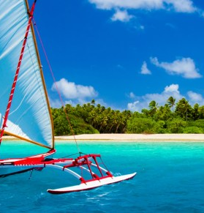
The Aloha Leadership Project: Bringing Aloha/Kindness to the Schools
School partners were to choose projects that demonstrate kindness, also identify projects that would encourage and reward kindness
Aloha Leadership Principles: Caring, Kindness, Compassion, Building Community, Listen carefully, Value relationships, Collaborate together, Eliminate Hate and Bullying, spread Aloha
Some projects are continuing through June
This Photo by Unknown author is licensed under CC BY-SA-NC.

Slide 12

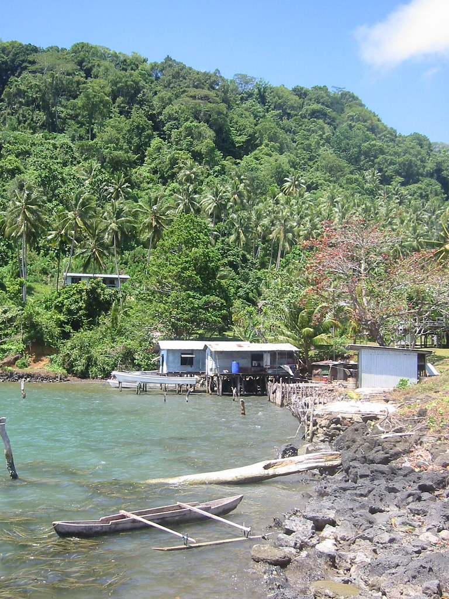
The School Safety Plan:
Identifying School Safety Needs
Each school received a copy of the Educator's Guide to Comprehensive School Safety Plans from the Los Angeles County Office of Education
As a School Safety Committee, identified needed supplies to support the School Safety Plan
This Photo by Unknown author is licensed under CC BY-NC-ND.

Slide 13

Examples of School Safety Plan Projects
Collins Elementary School: Student Safety Ice Packs for student injuries
Other items purchased by the schools included emergency kits, first aid kits, water, food, clipboards, megaphones, whistles, signage of school procedures, emergency lighting

Slide 14

Examples of Aloha Leadership,
Kindness Projects
Buena Vista High School: Created Holiday Gift Baskets for students/families in need of food and holiday gifts
Collins Elementary School: St. Patrick's Day Staff Appreciation Table with snacks, treats and beverages for School Staff
Collins Elementary School: Student Ribbons for students who demonstrated kindness, responsibility and respect

Slide 15
Mahalo to LBCEI, The Non Profit Partnership, and Cal Wellness for this opportunity
Let us know how we can support North Long Beach Schools and the North Long Beach Community
National Pacific Islander Education Network (NPIEN) www.npien.com npien@npien.com

Slide 16
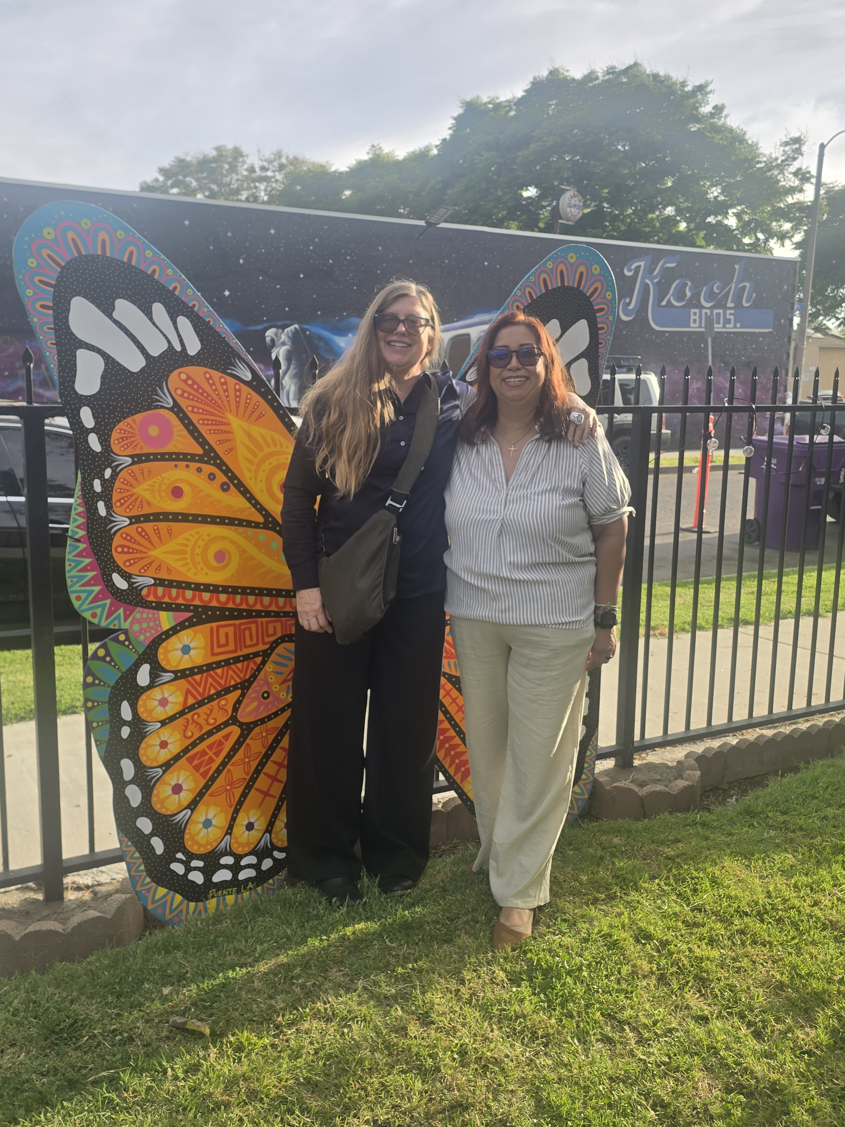
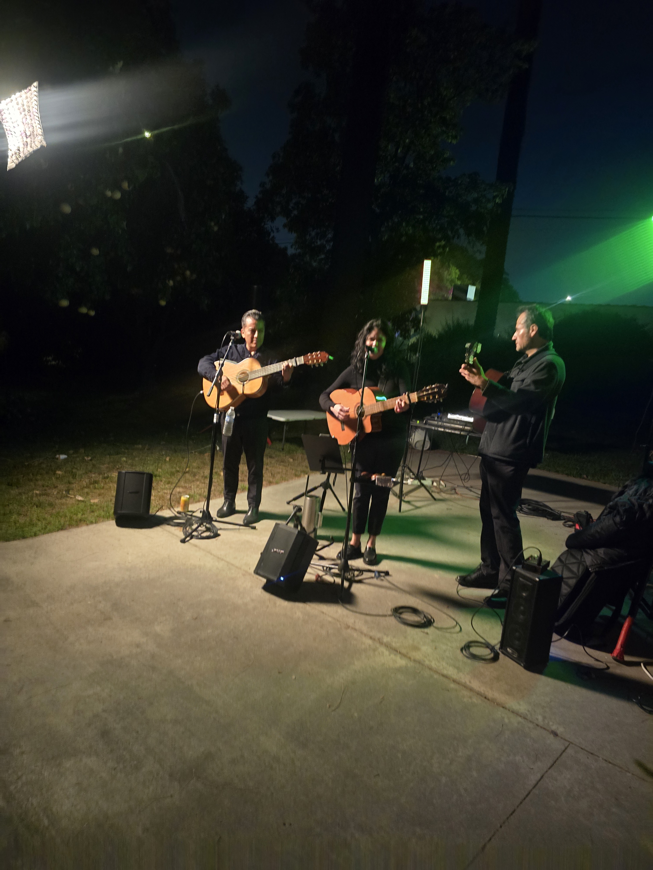
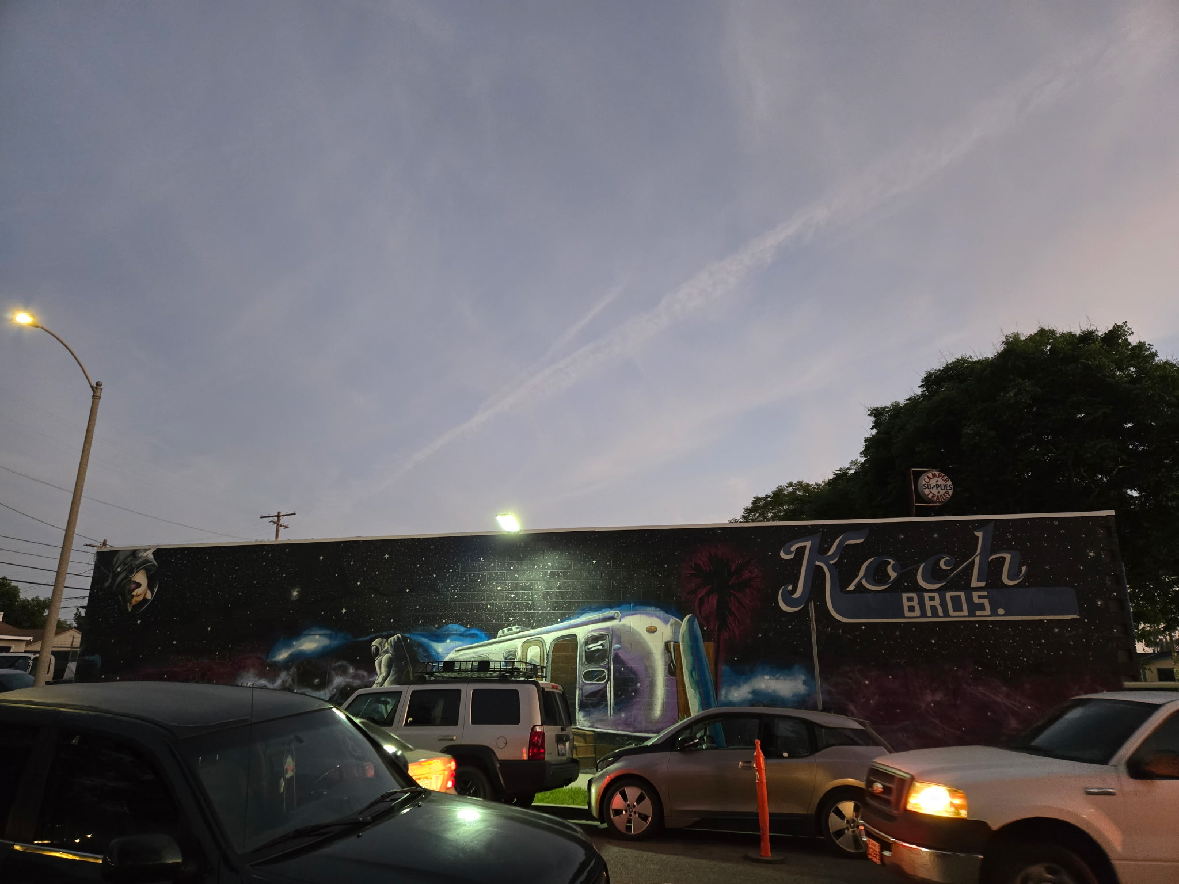
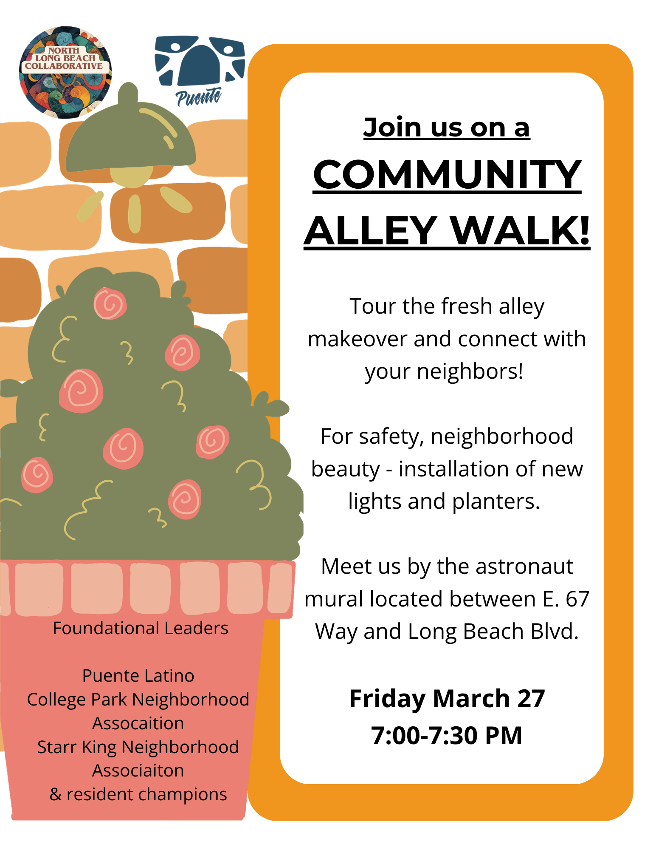
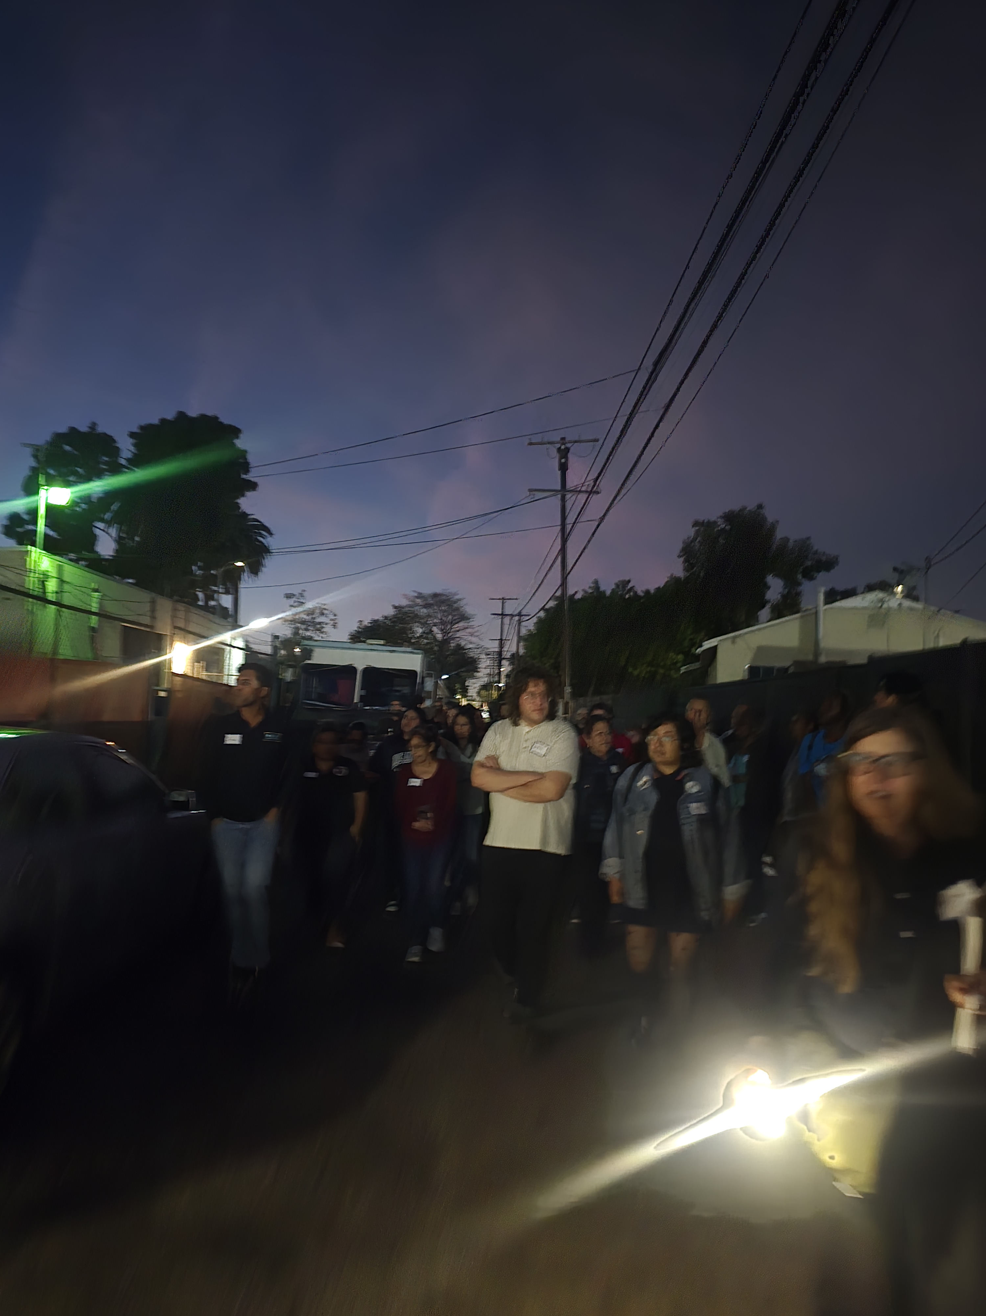
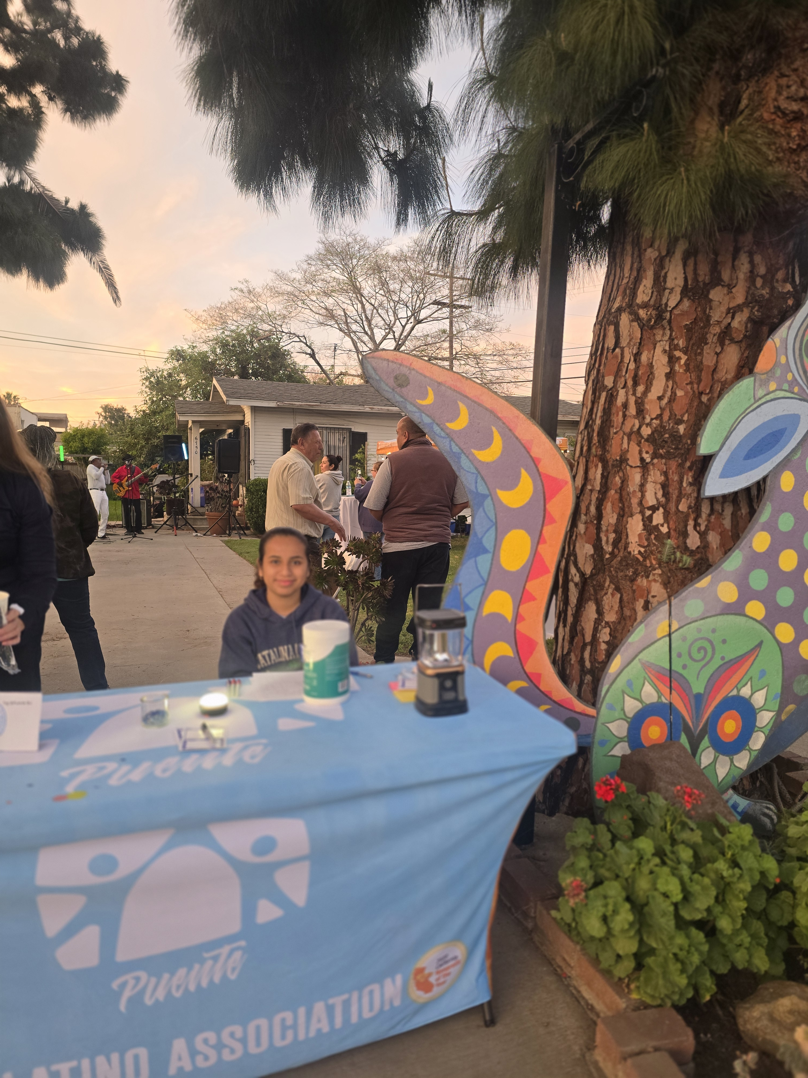
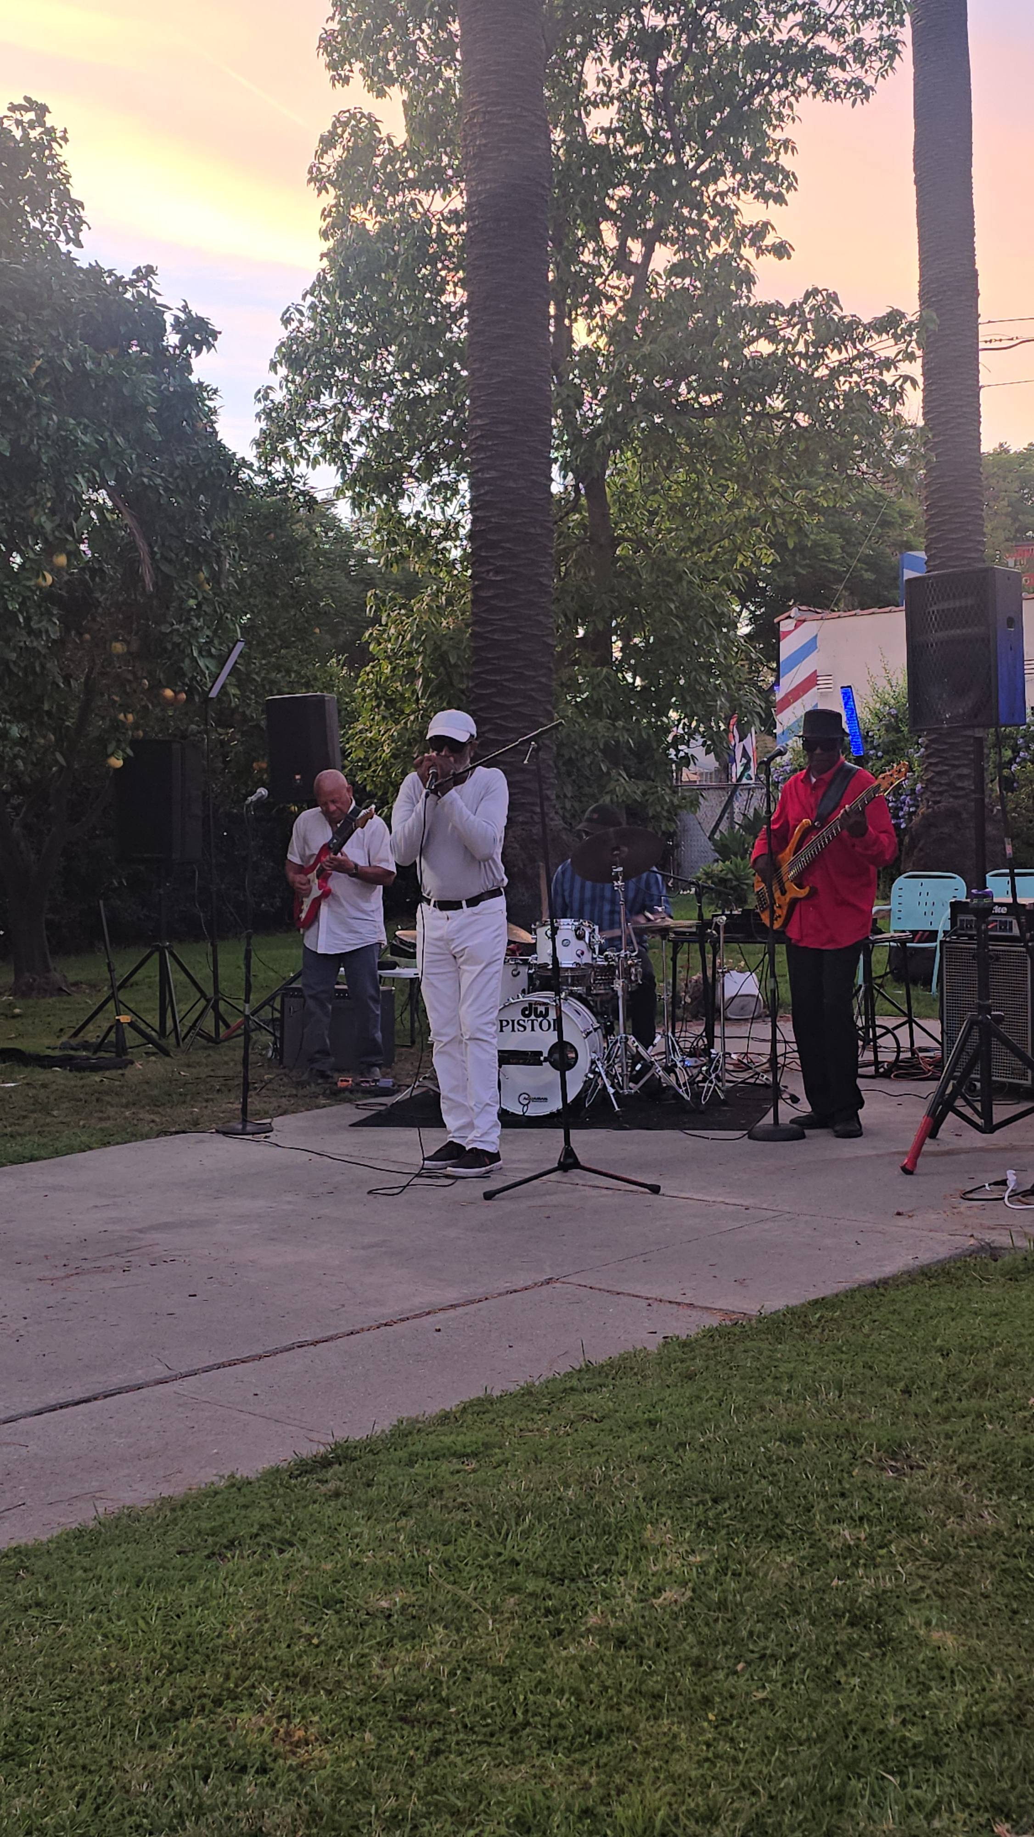

Slide 17
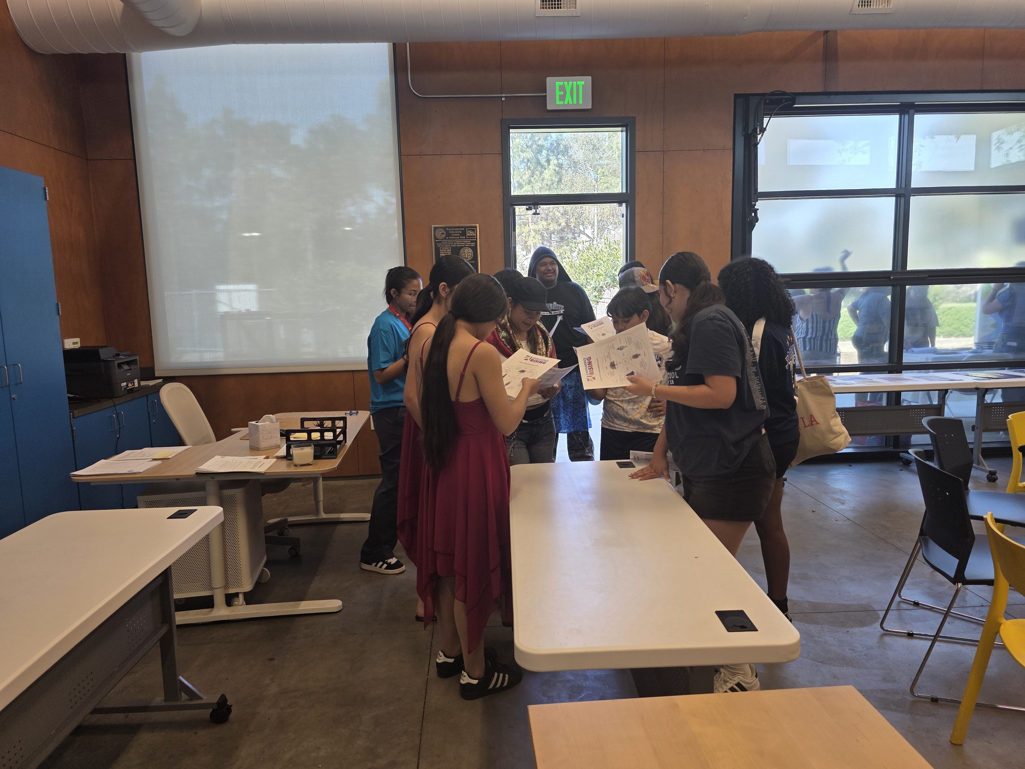
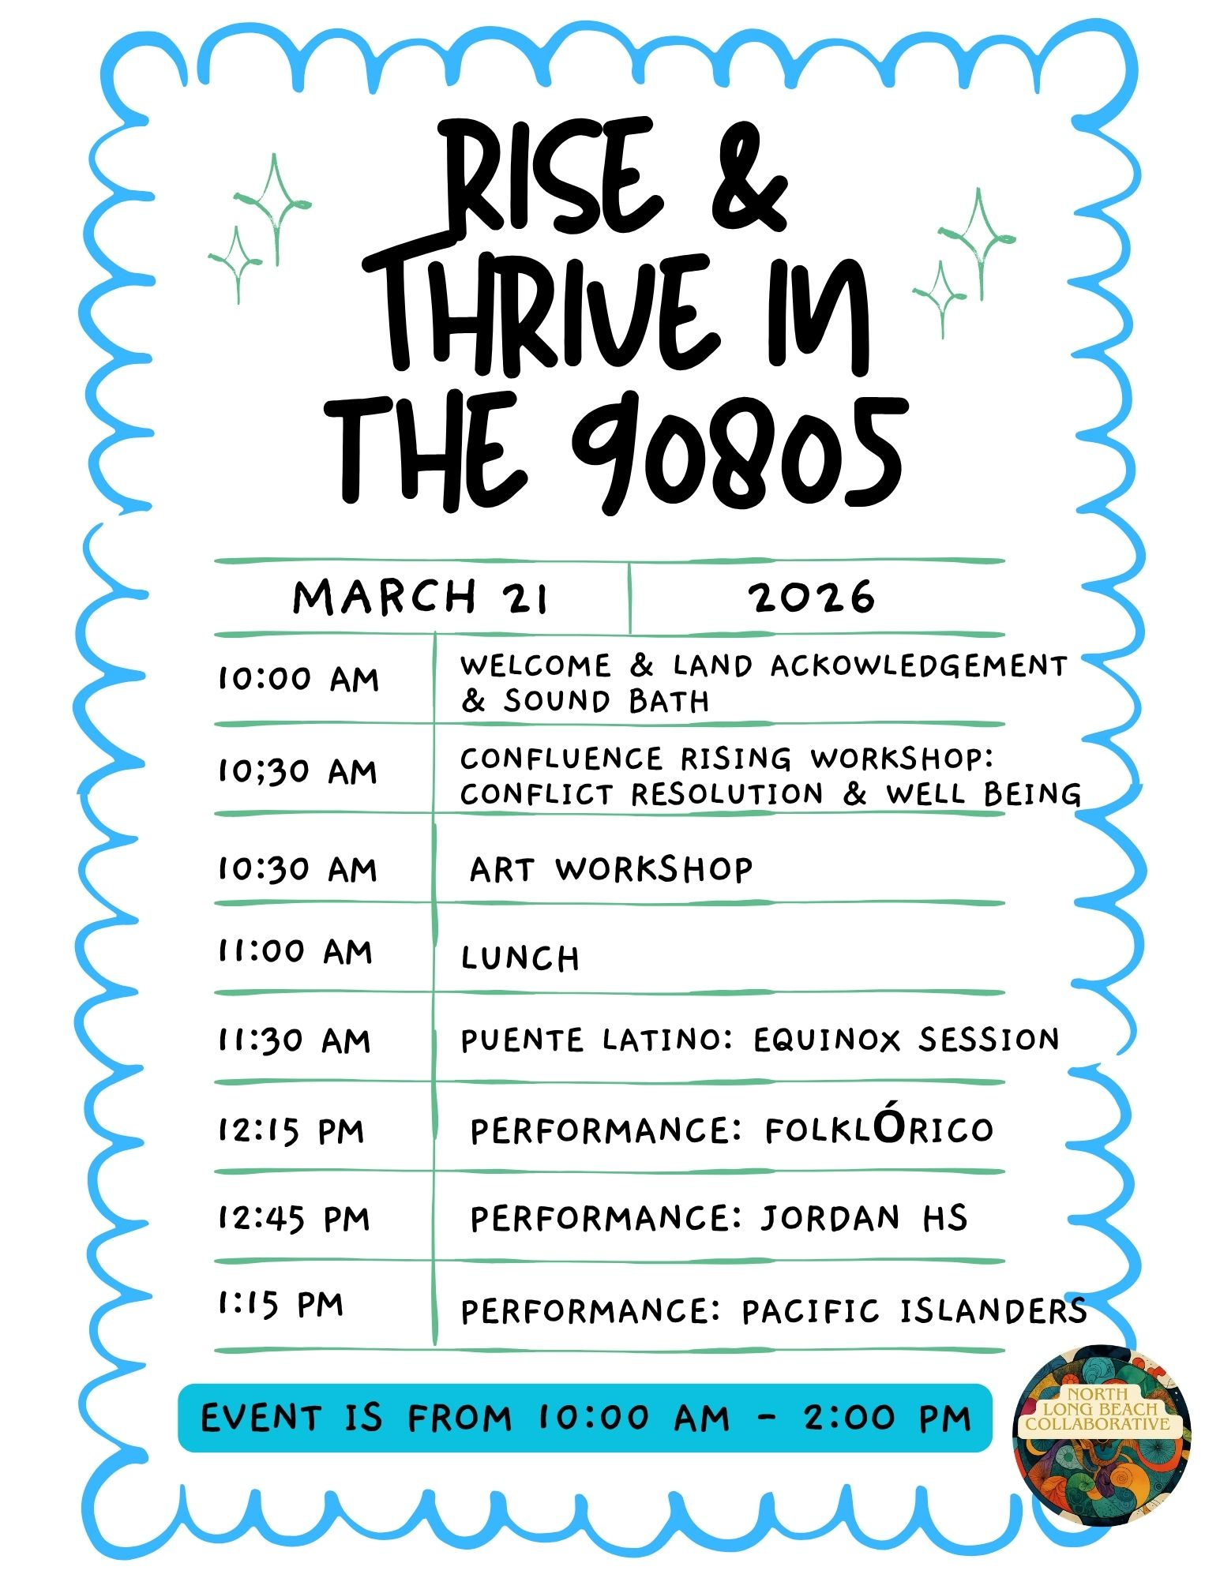
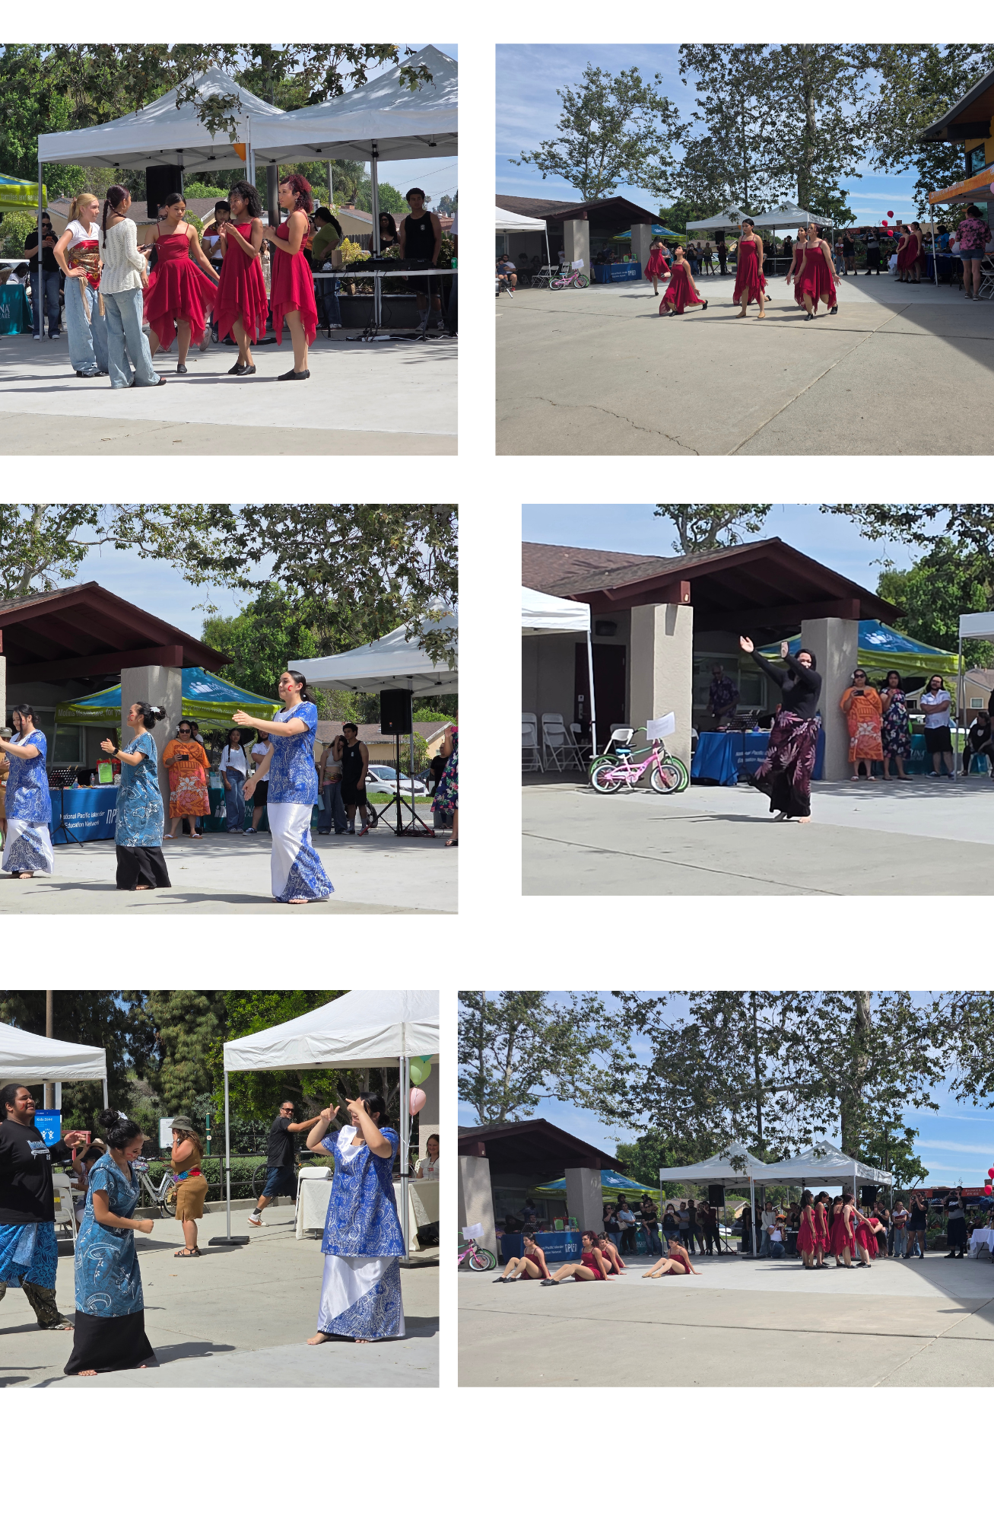
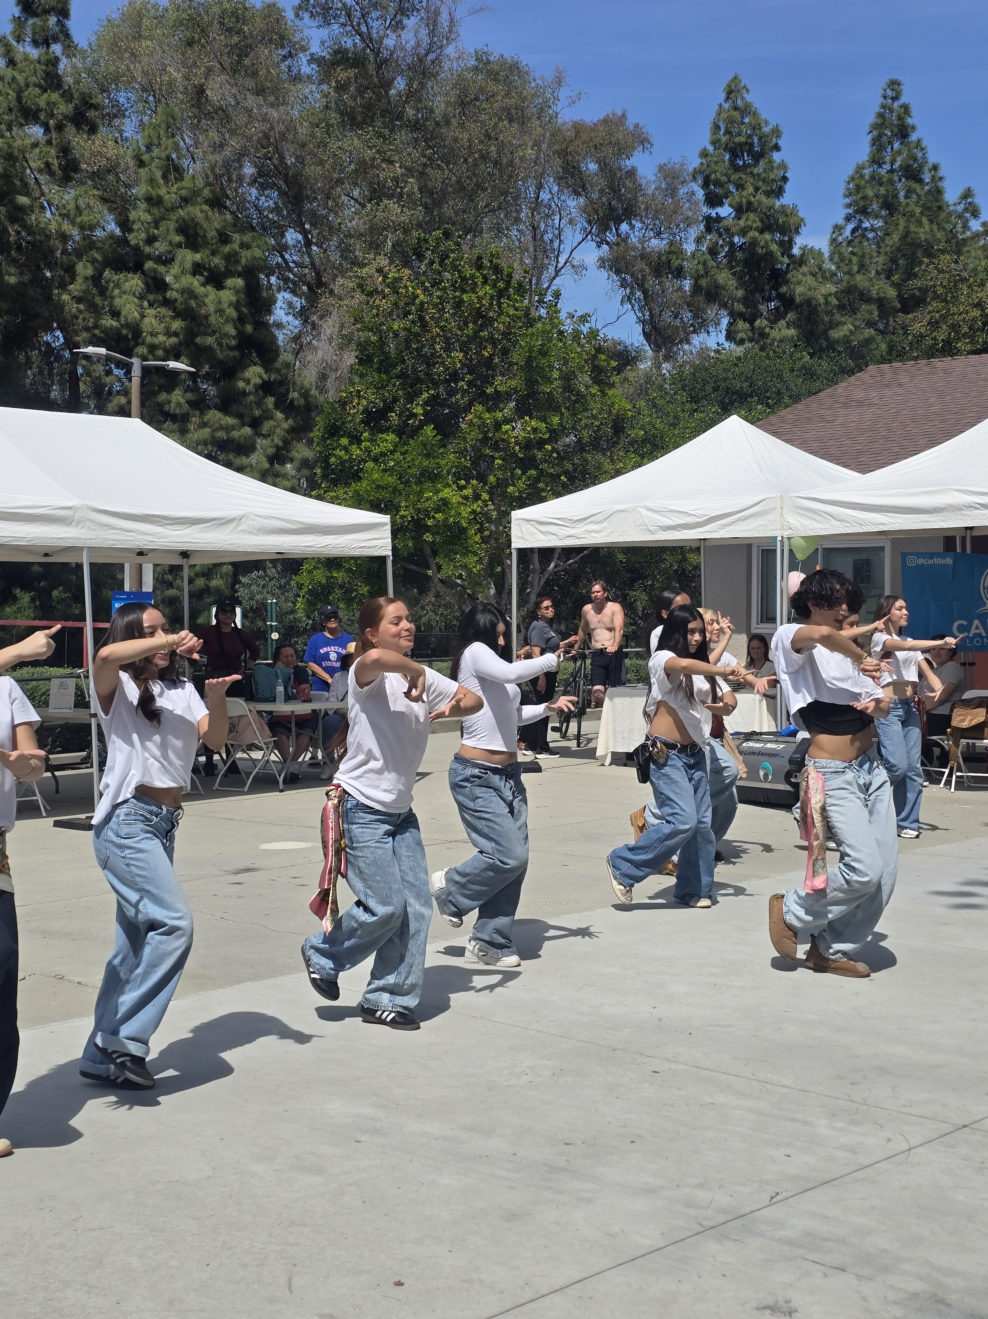
Types of Events Adults Requested
Continued importance of culture and healing events
More frequent mentions of health & wellness, resource fairs, and family events
Broader focus on community support and practical resources
Types of Events Youth Requested
Strong emphasis on culture and healing events
High visibility of youth events, sports, arts, and music
Requests lean toward activities, creativity, and peer engagement

Slide 18
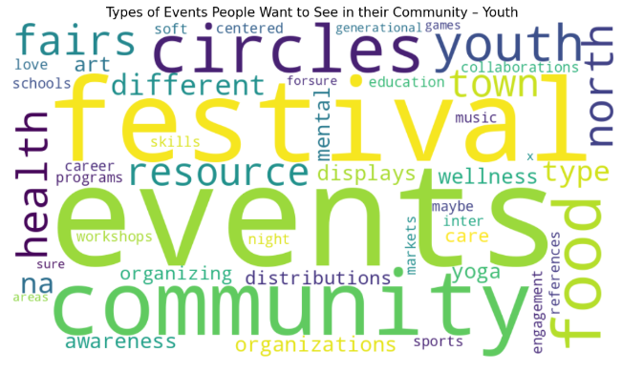
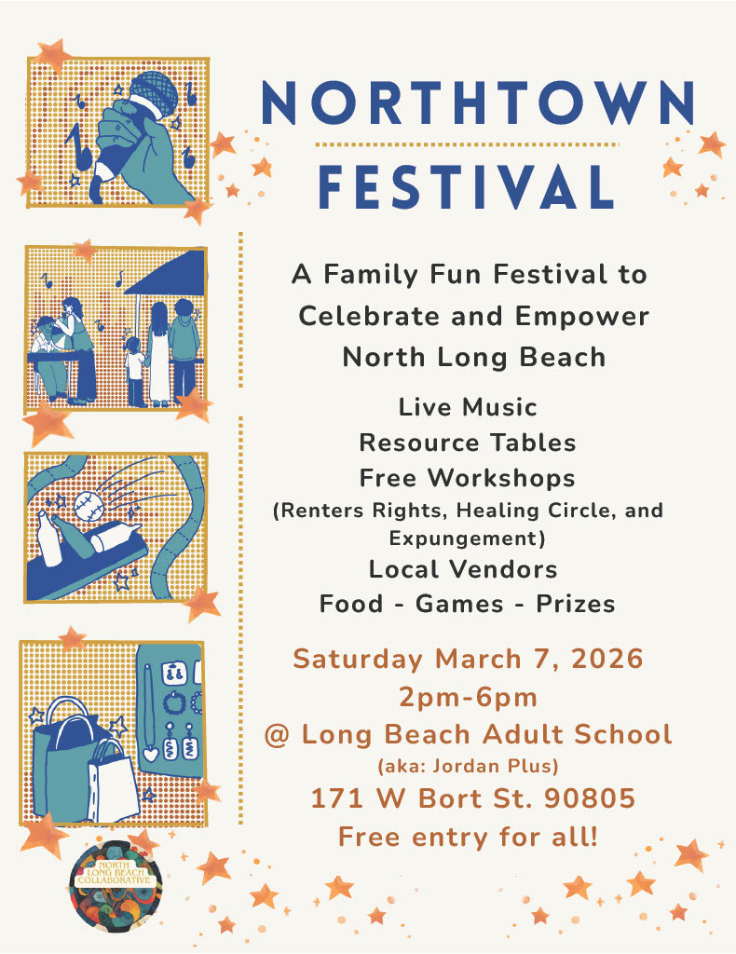
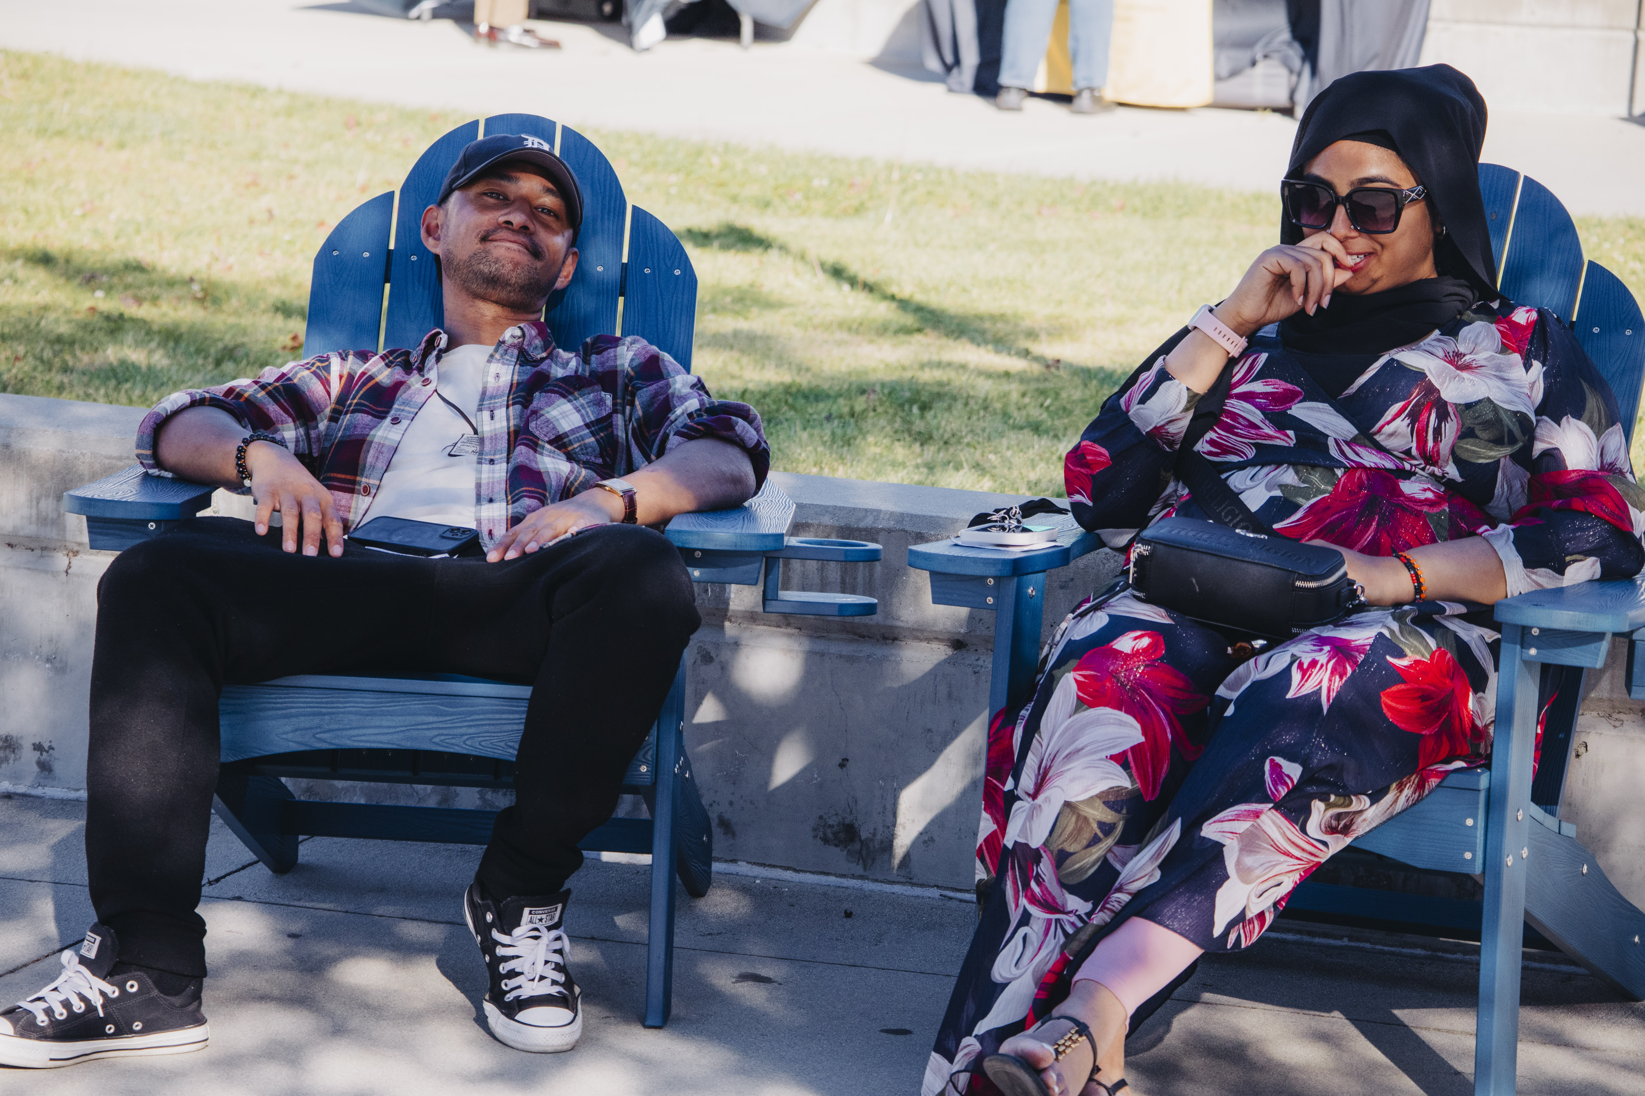
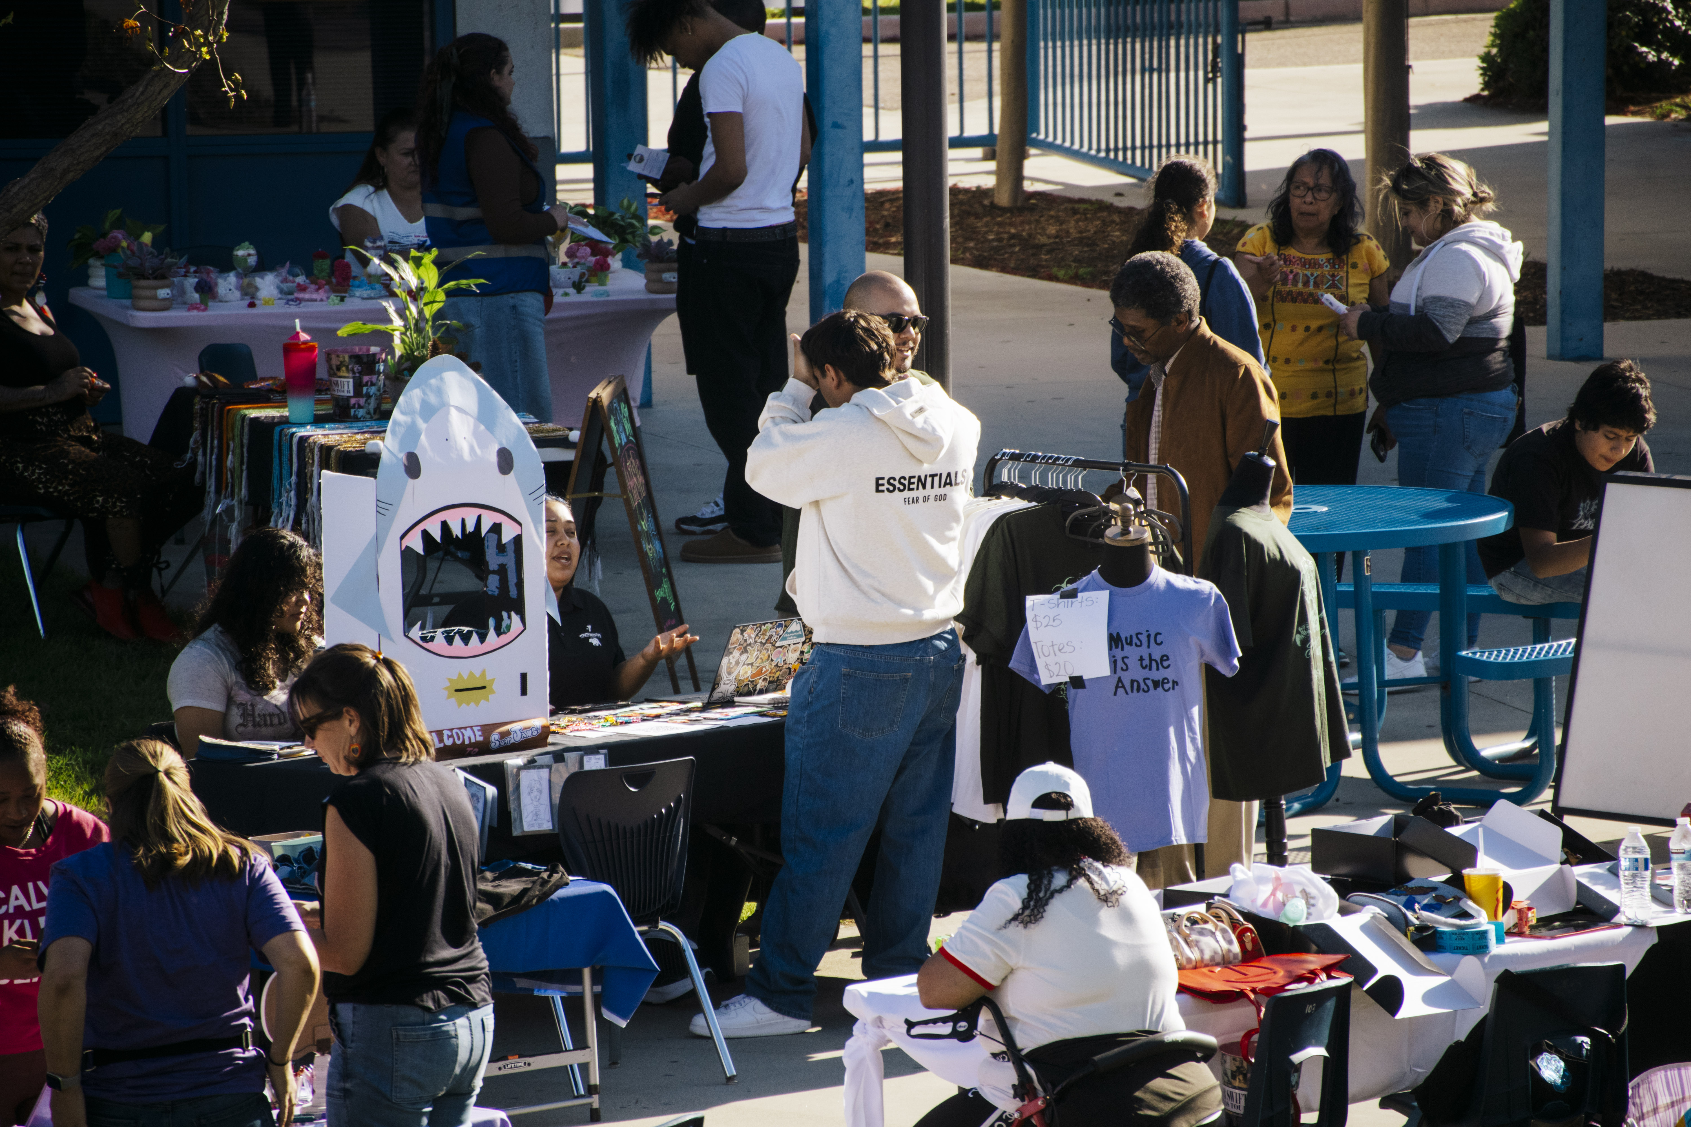
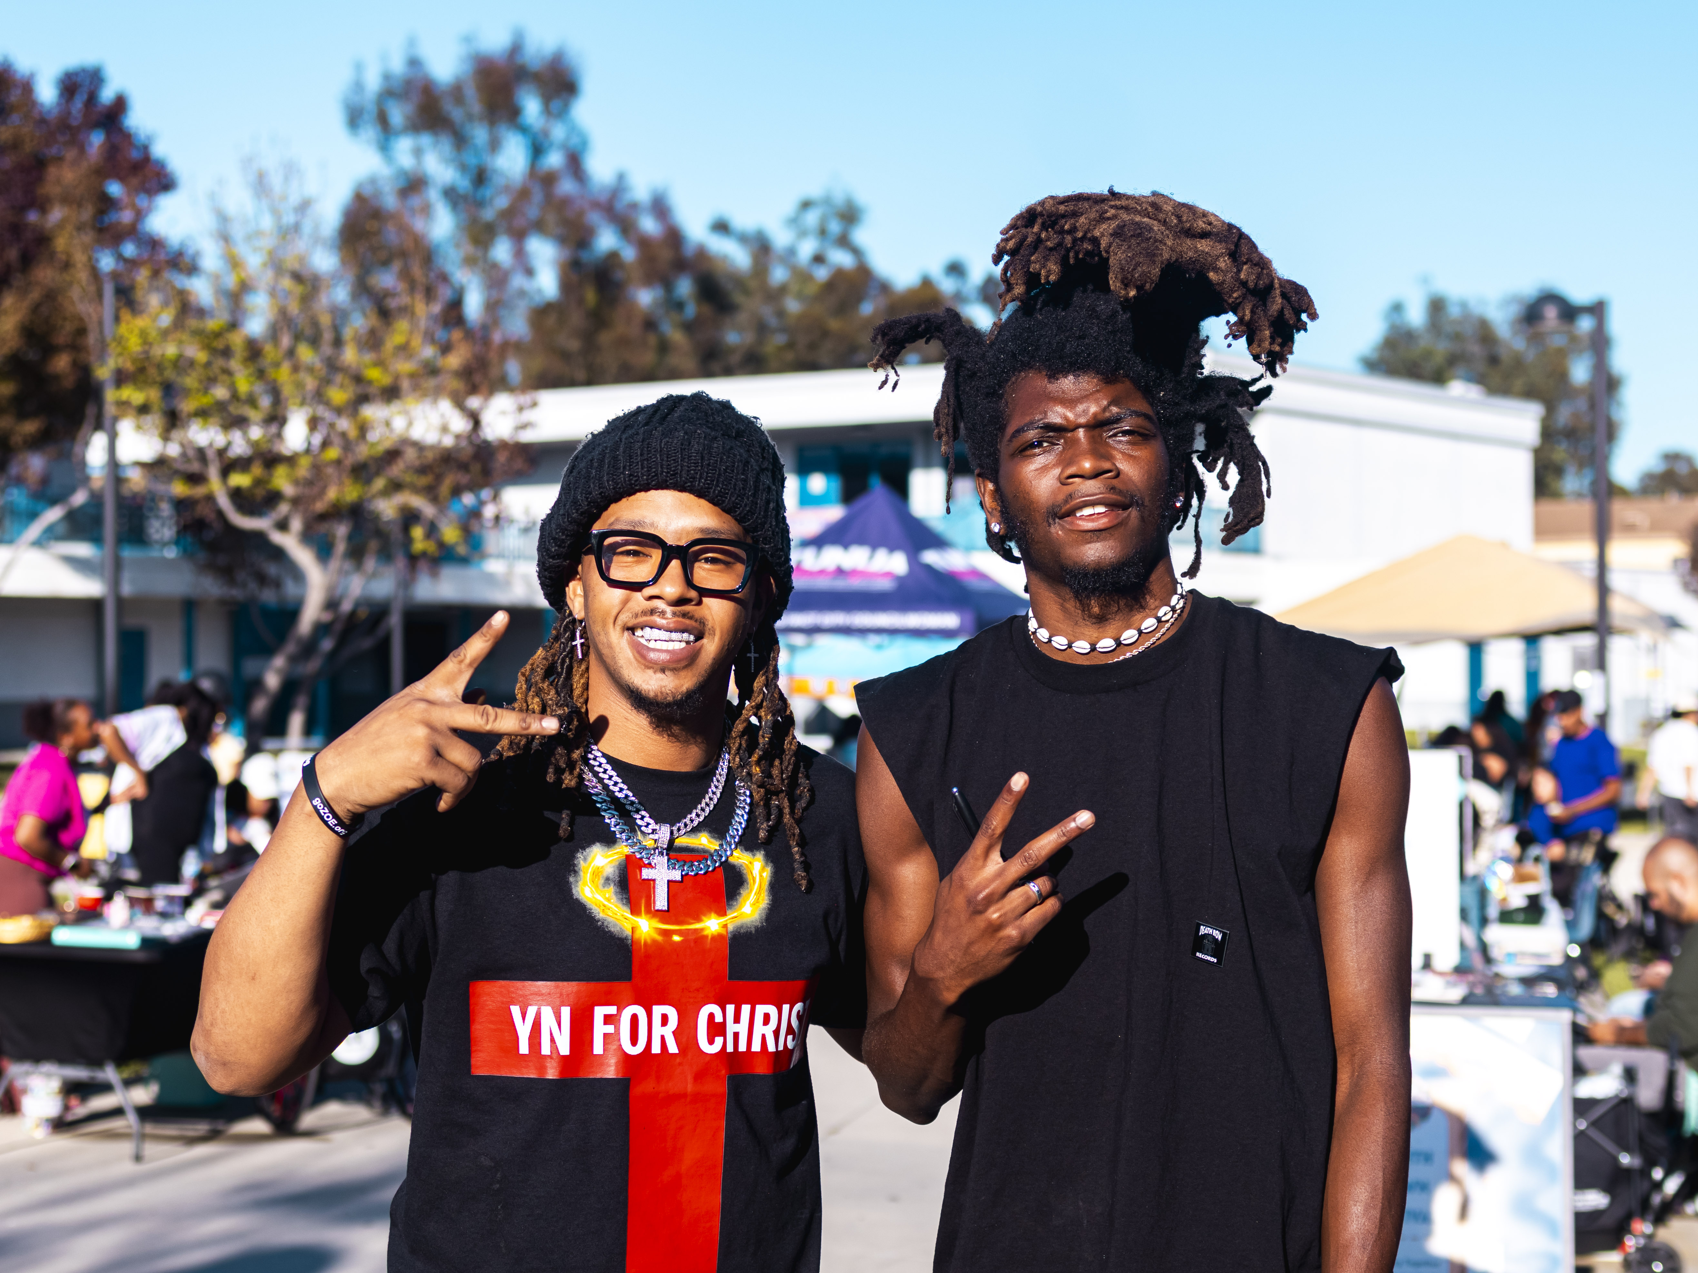

Slide 19

Group Picture/
5 – Minute Break

Slide 20
Social Cohesion Activity: “What We Built Together”
In small groups of 4 or 5, participants dialogue about the following questions.
• What strengthened trust and connection
• What created belonging and inclusion
• What participants want to carry forward

Slide 21
An Open Conversation – Phase II
Discussion prompts:
What should Phase II evolve into?
What considerations are critical moving forward?
What resources, training, or skills are needed?
Anything else we need to consider?

Slide 22

Next Steps
•Interest form was emailed; expect a call to encourage completion of the interest form
•Plan a future mixer to report back on Phase II

Slide 23
Acknowledgements/ Closing
One-word reflection or gratitude round
Notes:
Hand out certificates

Slide 24

Your Participation Makes the Difference
Thank you!

Slide 25
